Slide 1
Sustainable and inclusive growth for New Zealand
NZ Shippers Council

Slide 2
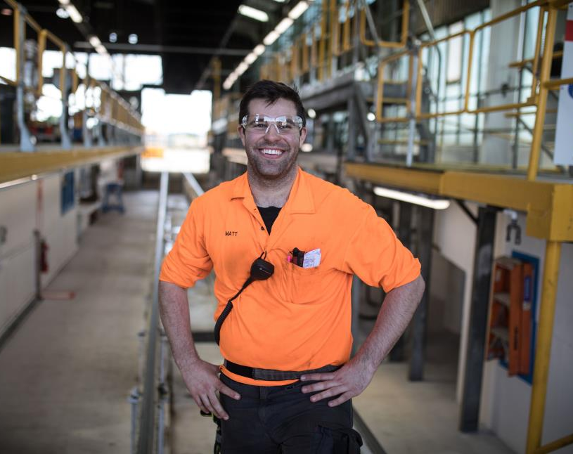
Today
Value of Rail to NZ
Our Focus
Half year result
Import/Export freight flow
Challenges
Forward Outlook
Matt Hermann, Team Leader

Slide 3
Notes:
Key to understanding all of the benefits rail can bring is being able to tangibly see them in our communities. Which is why we created this social media video.

Slide 4
Value of Rail to New Zealand

Slide 5
Value of Rail to New Zealand

Slide 6
Half year result 2018
$15.3 MILLION
operating profit
Up 39%
$40 MILLION
underlying operating up excluding $25m earthquake impact
$7 MILLION
productivity and efficiency savings building on $45m last 2 years
EXCEEDED
commitment to Government for third year running

Slide 7
Our Focus
Our vision: Trusted, Kiwi-owned logistics partner, growing New Zealand
Our purpose: We move people and freight
OUR STRATEGIC THEMES
SUSTAINABILITY FRAMEWORK
OUTCOMES FOR NEW ZEALAND
Simplify
Customer
Reliable
ZERO HARM
Standardise
Culture
Sustainable
Invest
Valuable
Commercial
OUR GUIDING PRINCIPLES
BELONGING
One proud KiwiRail family/whanau
BELIEVING
Customer growth mindset, better every day
BEHAVIOURS

Slide 8
Export – Import volumes critical to KiwiRail
Total external revenue
Freight trading revenue by sector
Freight
Interislander
Property and Corporate
Scenic Journeys
Infrastructure and Asset Management
Domestic
Forestry
Import / Export
Bulk
Notes:
Volumes affected by Kaikoura earthquake
Continued growth in forestry
Port growth strategy sees Port of Tauranga volumes up 12%
Main North Line back 10 months after quake in a limited capacity
Tourism showing strong growth pre-earthquake

Slide 9
Rail share of port container traffic
Direction | Port Name | 2012 (%) | 2013 (%) | 2014 (%) | 2015 (%) | 2016 (%) | 2017 (%)
Gate in | Ports of Auckland | 5.5 | 8.2 | 10.5 | 8.3 | 3.5 | 2.3
 | Port of Tauranga | 34.3 | 37.0 | 45.3 | 46.8 | 50.1 | 47.3
 | Port of Napier | 25.2 | 23.4 | 18.9 | 11.5 | 9.9 | 15.4
 | Port Nelson | 0.0 | 0.0 | 0.0 | 0.0 | 0.0 | 0.0
 | Lyttelton | 37.6 | 30.2 | 22.2 | 15.3 | 17.4 | 16.7
 | Primeport Timaru | 24.3 | 24.2 | 7.9 | 13.4 | 32.7 | 28.0
 | Port Otago | 39.6 | 43.5 | 40.3 | 42.5 | 45.2 | 45.1
 | Southport | 0.0 | 0.0 | 0.0 | 0.0 | 0.0 | 0.0
Gate out | Ports of Auckland | 7.2 | 6.9 | 10.6 | 9.3 | 5.1 | 5.0
 | Port of Tauranga | 34.0 | 28.4 | 28.6 | 34.3 | 41.6 | 41.3
 | Port of Napier | 3.5 | 6.4 | 16.1 | 9.8 | 8.4 | 13.4
 | Port Nelson | 0.0 | 0.0 | 0.0 | 0.0 | 0.0 | 0.0
 | Lyttelton | 24.0 | 11.1 | 1.3 | 1.0 | 4.6 | 7.0
 | Primeport Timaru | 31.5 | 32.8 | 12.4 | 5.3 | 6.4 | 4.5
 | Port Otago | 33.1 | 38.1 | 34.8 | 34.7 | 36.6 | 38.3
 | Southport | 0.0 | 0.0 | 0.0 | 0.0 | 0.0 | 0.0
ALL NEW ZEALAND, EXCLUDING CENTREPORT
PORT OTAGO MOVEMENTS WITH ROAD/RAIL UNKNOWN
Direction | 2012 (%) | 2013 (%) | 2014 (%) | 2015 (%) | 2016 (%) | 2017 (%)
Gate in | 25.3 | 24.7 | 24.4 | 22.7 | 24.7 | 23.9
Gate out | 19.0 | 14.6 | 14.8 | 15.2 | 17.5 | 18.4
Direction | 2012 (%) | 2013 (%) | 2014 (%) | 2015 (%) | 2016 (%) | 2017 (%)
Gate in | 34.4 | 29.2 | 34.4 | 35.9 | 33.0 | 33.1
Gate out | 32.8 | 26.3 | 31.4 | 32.7 | 31.4 | 30.5
Notes:
The Port Otago rail rate may be incorrect around a third of their movements are unknown (see graph)

Slide 10
Relative size of ports - TEU
Source : NZTA Web Site – Port Container Trends – Total Loads and Discharges (P1) http://www.transport.govt.nz/sea/figs/containers/port-trends-1/

Slide 11
Challenges
Getting MNL back to capacity
High exposure to commodity exports
Evolving supply chains and freight
flows – super ships
Excess capacity on Cook Strait
Fit for purpose “Smart” Assets
Future of
work challenges
Technological disruption
Ageing workforce
Long-term Funding

Slide 12
Forward Outlook
Efficient Hub and Spoke Systems
Intelligent Assets
Interislander (Ships and Shore)

Slide 13
Forward Outlook- Services
Customer Information Platforms
Intermodal Freight Hubs
Tourism Models
Connected Teams and Partners

Slide 14
Questions

