Slide 1
Driving our economy

Slide 2
Sector overview
92.9% of the freight task
5,200 road freight companies
30,000 truck drivers
$6b annual contribution to GDP

Slide 3
Industry trends
Acquisitions and consolidation
Falling freight volumes
Ongoing cost increases
Tight margins

Slide 4
Tight margins

Slide 5
Sector representation
Why are there three road freight associations?
Can we work together effectively?

Slide 7
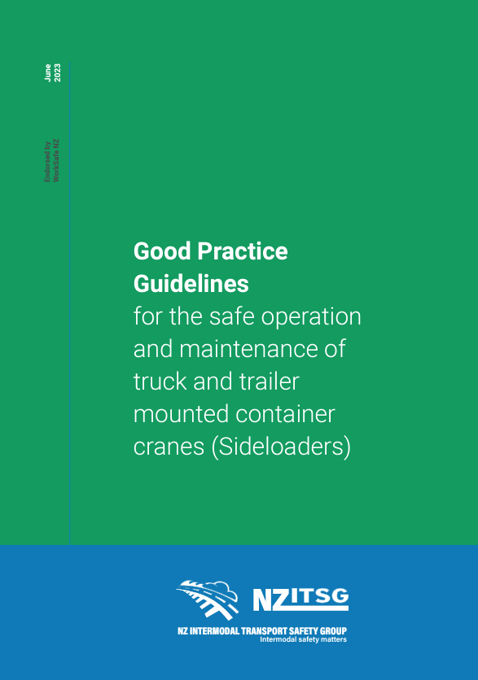
Industry collaboration
TNZ Ports and Intermodal Sector Group
NZ Intermodal Transport Safety Group
South Island Port User Working Group

Slide 8
Consulting, cooperating & coordinating
Vehicle booking systems and port charges
Sanction systems
Good traffic management practices
Notes:
Consult, cooperate and coordinate on health and safety matters

Slide 9
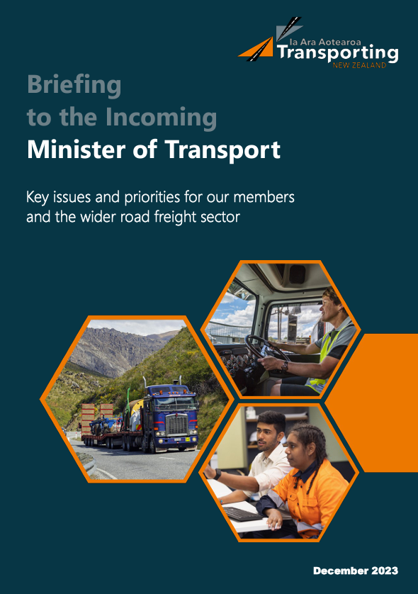
Common challenges
Roading and resilience
Driver shortages and workforce development
Regulation and supply chain pressures
Decarbonisation

Slide 10
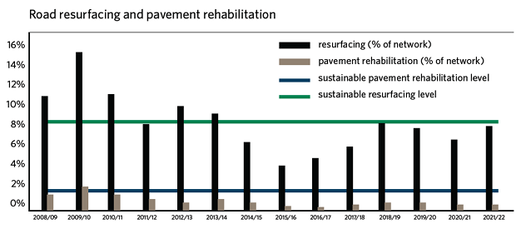
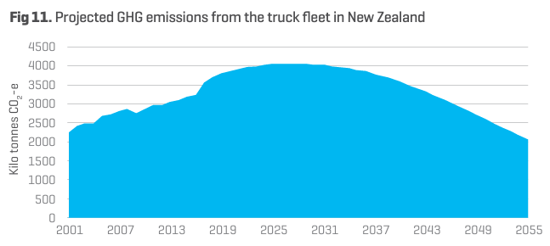
Roading and decarbonisation
Broad cross-industry concern about insufficient road maintenance and network resilience
Complete disconnect between ambition and policy settings on ZEVs

Slide 11
Transporting.nz billy@transporting.nz 027 304 1877

